Slide 1
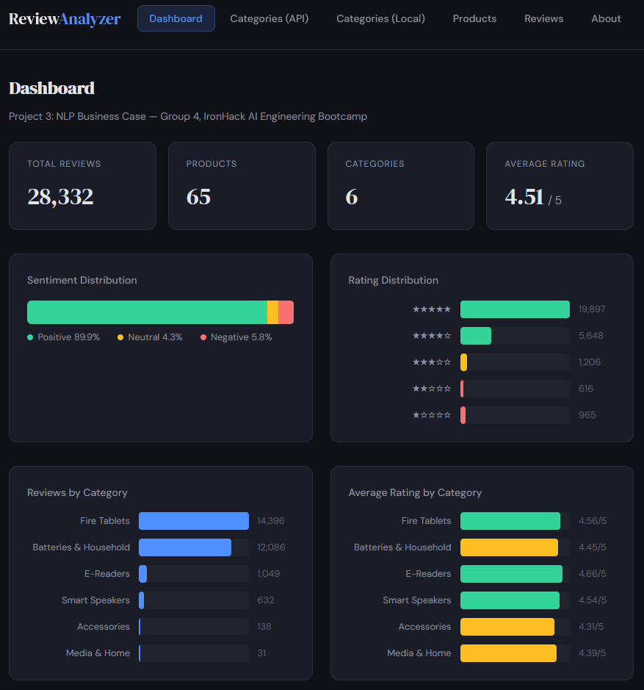
Review Analyzer
NLP Business Case - Automated Customer Reviews Analysis
Group 4
Felipe Doria & Krzysztof Giwojno
IronHack AI Engineering Bootcamp, February 2026
Notes:
Hi everyone, we're Group 4 — Krzysztof and Felipe. Our project is the Amazon Review Analyzer, and yes, it's live right now — you can open it on your phone if you want. Let's get into it.
[~15 seconds] K

Slide 2
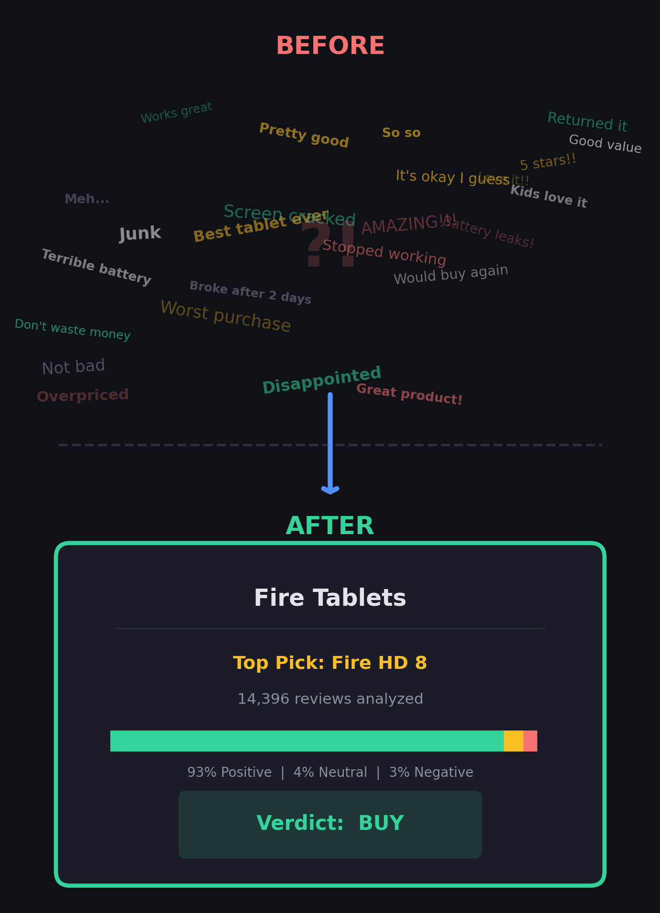
We Read Them All!
28,332 reviews. 65 products. One question: Which Amazon product should I actually buy?
We built a system that:
Reads every review and understands the sentiment
Groups 65 products into 6 meaningful categories
Writes recommendation articles - like a tech blogger, but cheaper ($0.43)
The result? A live website where you can browse categories, compare products, and read AI-generated buying guides.
No backend. No database. Just smart pre-computation.
Notes:
Imagine you're browsing Amazon and there are thousands of reviews. Who reads all of them? Nobody. So we built a system that does. It reads 28 thousand reviews, classifies each one's sentiment, groups products into categories, and then — here's the fun part — asks an AI to write recommendation articles. Like a tech blogger, but it costs 43 cents instead of a salary. And the whole thing is deployed as a live website you can browse right now.
[~1 minute] K

Slide 3
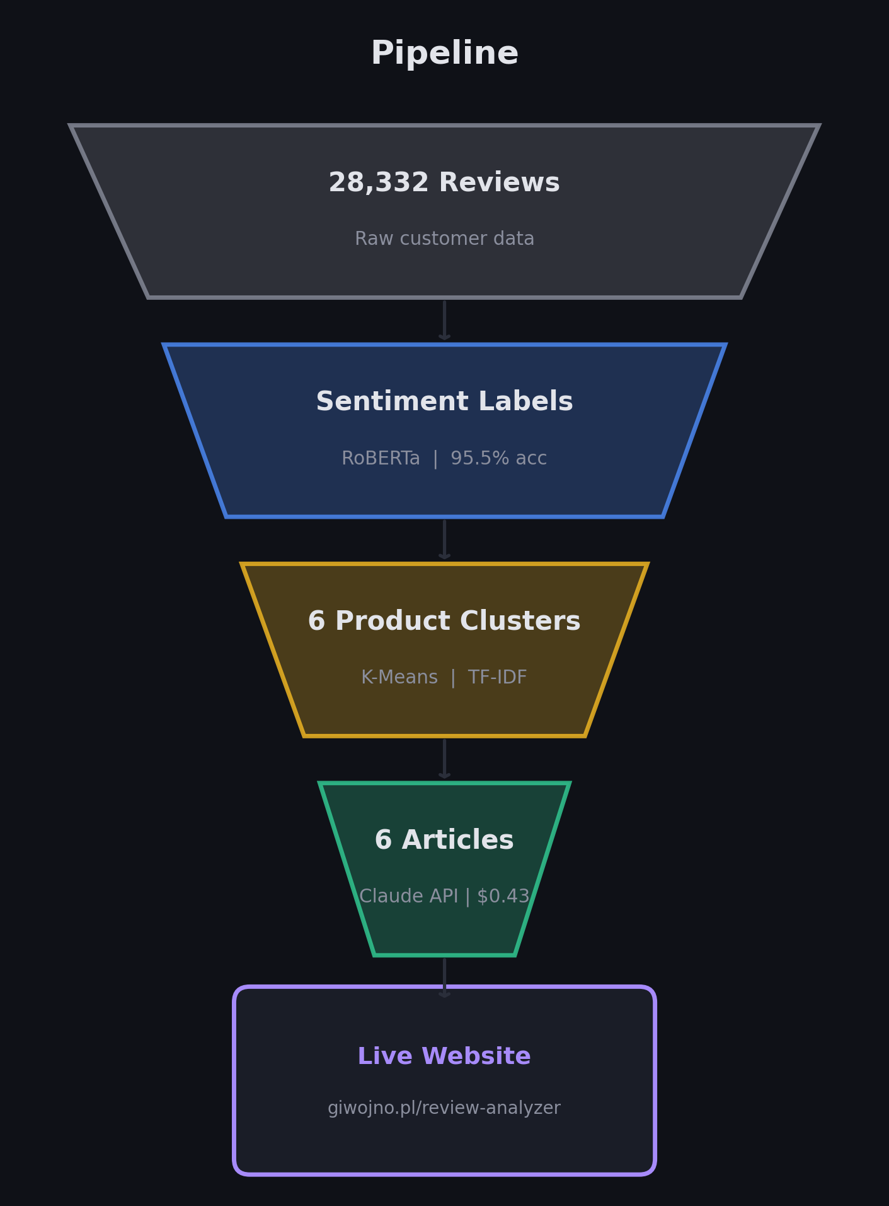
Introduction
The Real Problem
Companies get thousands of reviews but lack the tools to extract actionable insights at scale.
Our Solution: 3 Models, 1 Pipeline
Classification feeds sentiment labels to...
Clustering which groups products, then...
Summarization writes articles per cluster using the classified reviews as evidence
Each model's output is the next model's input. Classification quality directly affects summarization - if we misclassify a negative review as positive, the AI writes misleading recommendations.
Methodology: Fine-tuned transformers + unsupervised clustering + LLM-powered generation, deployed as a static web app.
Notes:
So what's the real problem? Companies get thousands of reviews but can't read them all. Our pipeline solves this in three connected steps. First, we classify every review's sentiment. Those labels feed into clustering — we group 65 products into 6 categories. Then the classified reviews become evidence for the AI to write recommendation articles. This is important — if classification is wrong, the summaries will be wrong too. The models are not independent; they're a chain. Now let me show you how we built each one.
[~1 minute] K

Slide 4
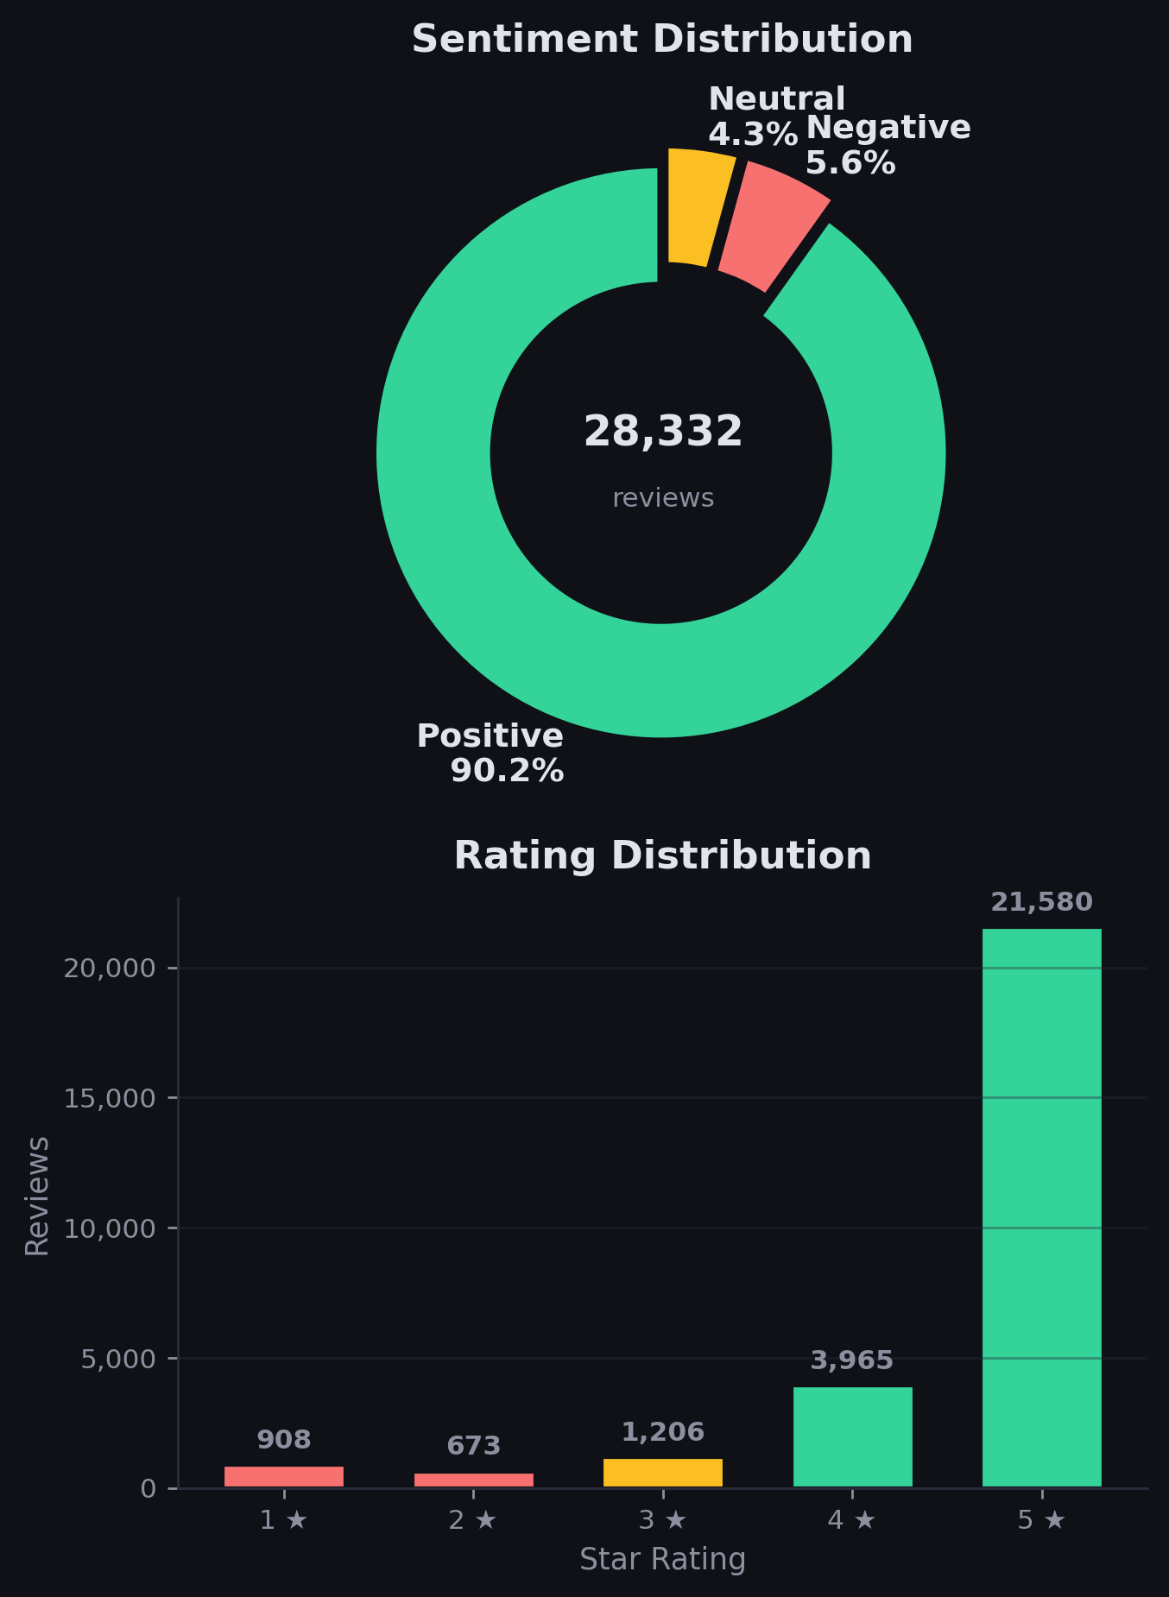
Methods
Dataset: Datafiniti Amazon Consumer Reviews (Kaggle)
28,332 reviews, 65 products, 24 columns
Reviews from 2009–2019
All Amazon-branded: Fire Tablets, Kindle, Batteries, Echo
Preprocessing:
Dropped 10 columns (>99% null or metadata)
Kept 35.87% duplicate texts (legitimate short reviews)
Mapped ratings: 1–2★ → Negative, 3★ → Neutral, 4–5★ → Positive
No text cleaning for transformers (they handle raw text)
The Challenge: 90% Positive, 6% Negative, 4% Neutral Training a model on this will predict "Positive" for everything and score 90% accuracy - but that's useless.
Notes:
Our dataset is about 28 thousand Amazon reviews across 65 products — tablets, batteries, Kindles, Echo speakers. After cleanup we kept 14 columns. The critical decision was sentiment mapping: 4 and 5 stars become Positive, 1 and 2 become Negative, 3 is Neutral. And look at this distribution — 90% Positive, only 4% Neutral. This is a massive class imbalance problem. A dumb model that always says Positive would get 90% accuracy. Our job was to build something that actually understands the minority classes.
[~1 minute] F

Slide 5
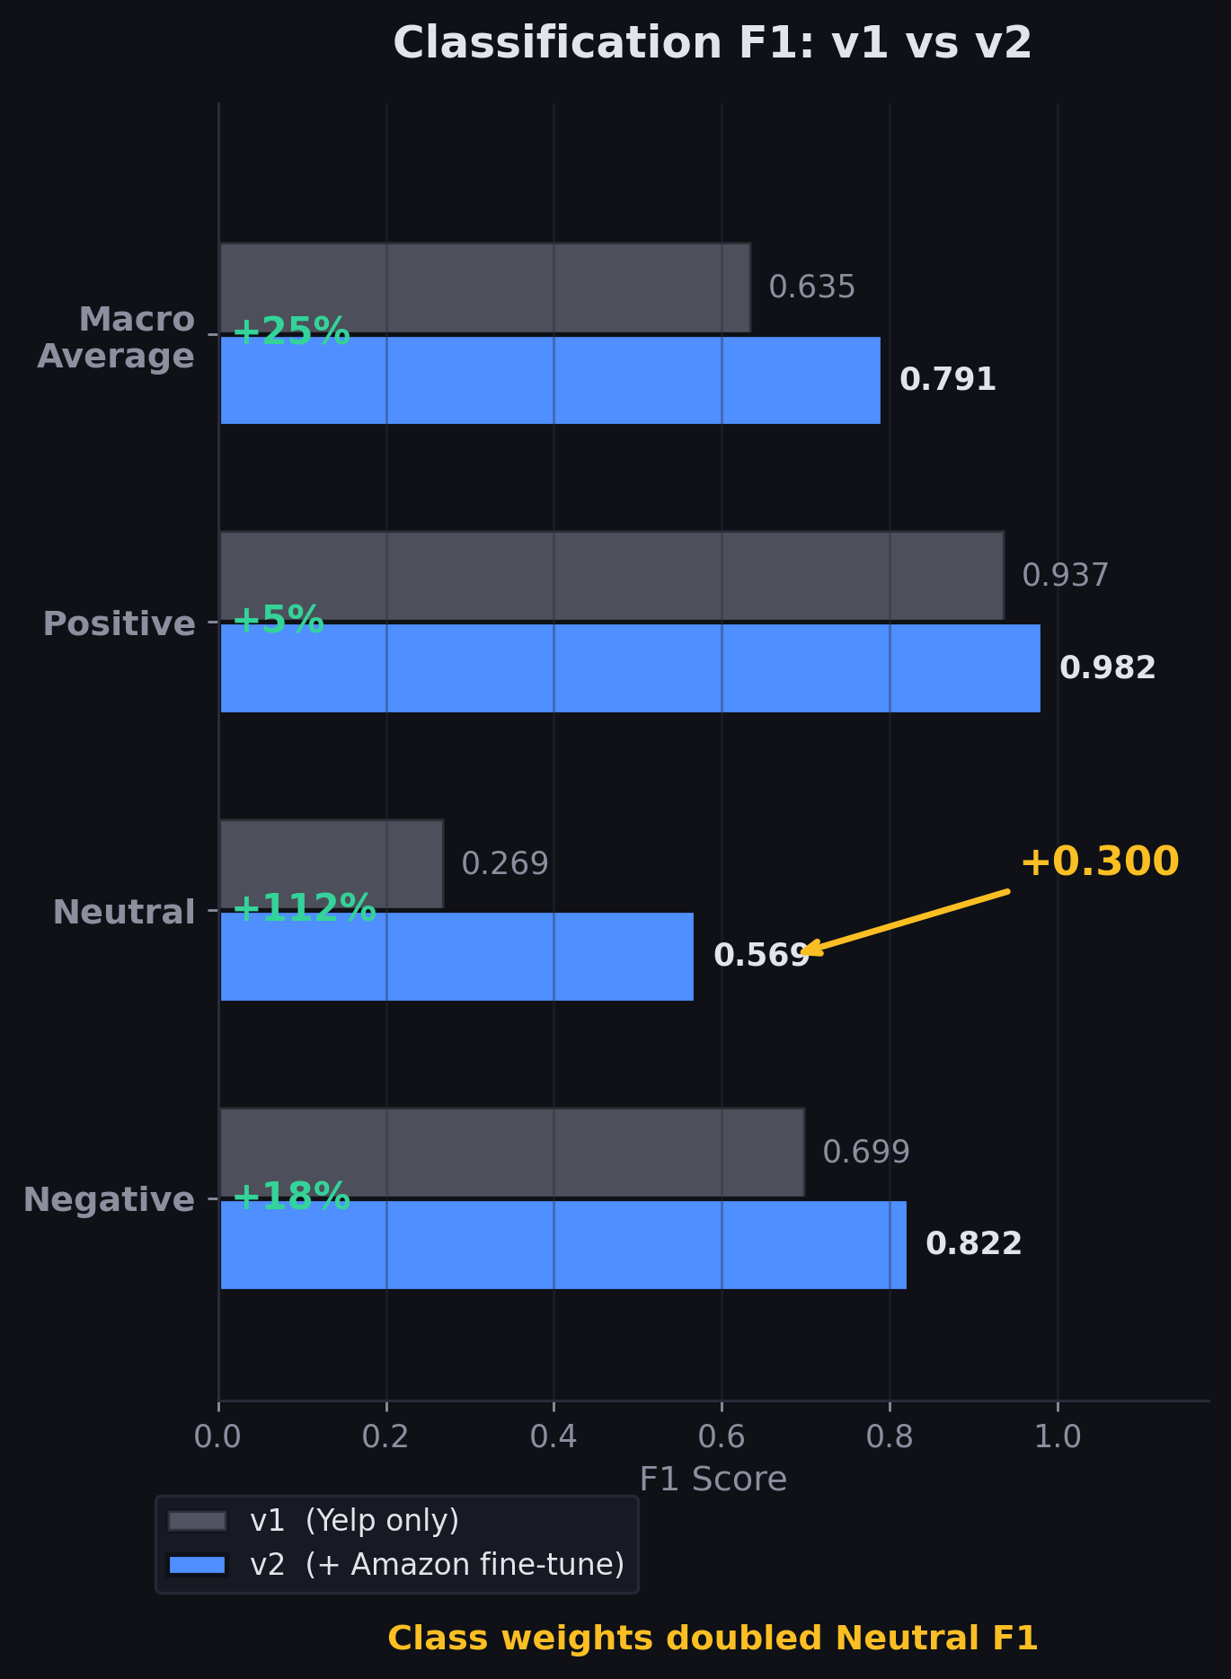
Model 1 — Classification
Task: Classify each review as Positive, Negative, or Neutral
What we tried:
RoBERTa-base (125M params) — transformer pre trained on large text corpora
Two-stage training:
Pre-trained on 650K Yelp reviews (3-class) → learns general sentiment
Fine-tuned on Amazon data with class weights → adapts to our domain
Key technique: Class Weights
Neutral gets 7.8x more importance during training
Negative gets 6.0x
Positive gets 0.4x (downweighted)
This forces the model to pay attention to rare classes instead of just predicting "Positive" every time.
Notes:
For classification, we used RoBERTa — a strong transformer model. But here's what made the difference. Our first version, trained only on Yelp data, got 87% accuracy but look at Neutral F1 — 0.27. Terrible. The model was basically ignoring Neutral reviews. So in version 2 we added class weights — we told the model: pay 7.8 times more attention to Neutral, 6 times more to Negative. We also fine-tuned directly on Amazon data with early stopping. The result? Neutral F1 jumped from 0.27 to 0.57 — more than doubled. That's the key insight: class weights saved this model.
[~1 minute] F

Slide 6
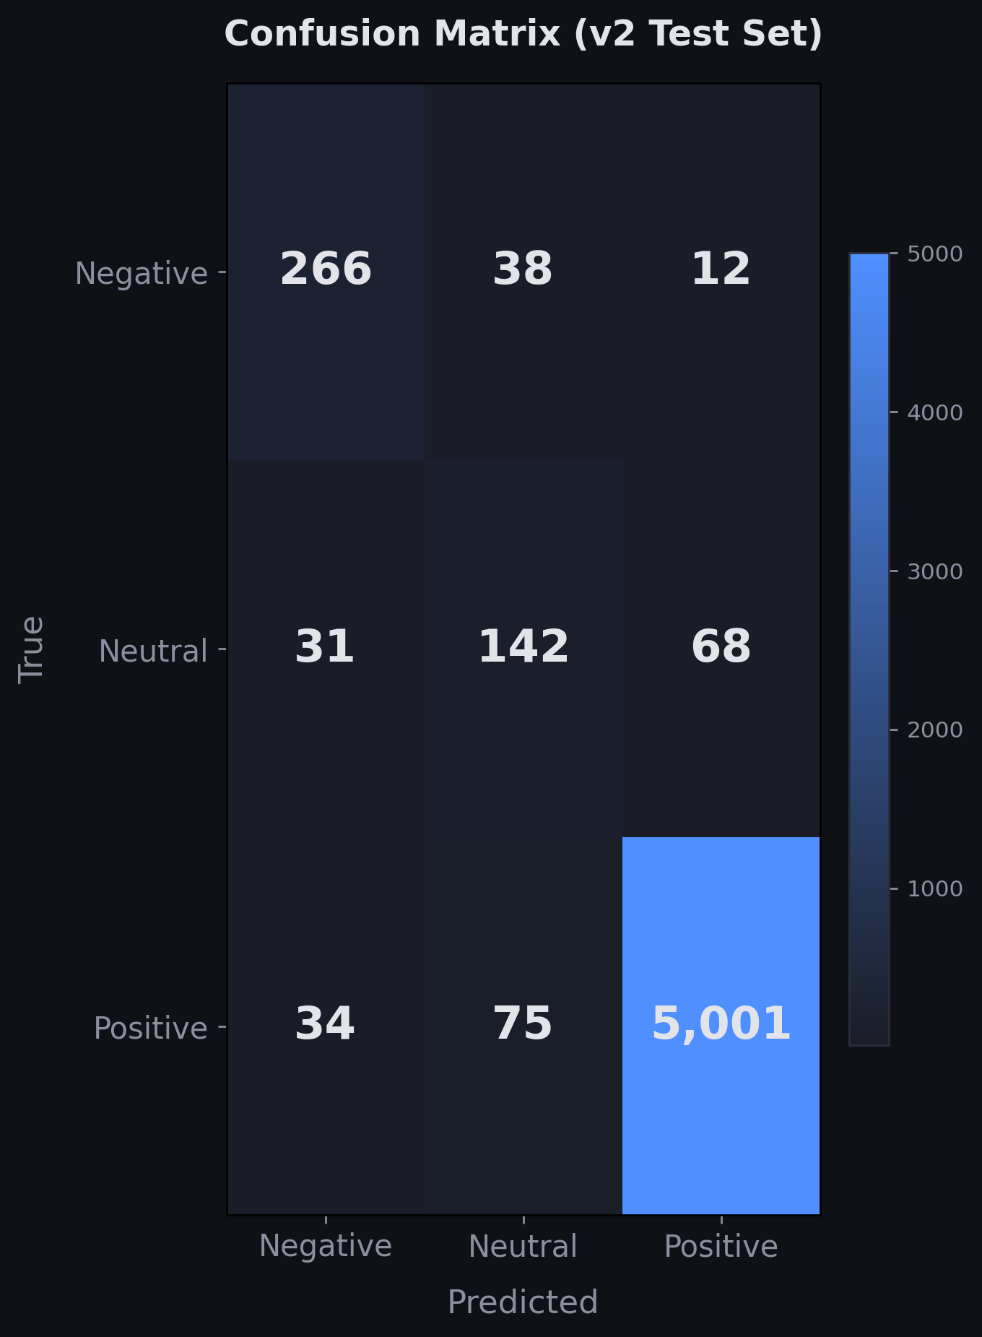
Model 1 - Evaluation
95.48% Accuracy | 0.791 Macro F1
Positive: Precision 0.985 | Recall 0.979 | F1 0.982 Neutral: Precision 0.550 | Recall 0.589 | F1 0.569 Negative: Precision 0.804 | Recall 0.842 | F1 0.822
Only 256 errors out of 5,667 test reviews (4.5%)
Where it fails:
Positive ↔ Neutral boundary (most errors)
Sarcasm and mixed-sentiment reviews
"It's okay I guess" — is that Neutral or Positive?
The worst error (Negative → Positive) happens only 12 times
Notes:
95.48% accuracy, but more importantly look at the confusion matrix. The diagonal is massive — 5,001 correct Positive predictions, 266 correct Negative, 142 correct Neutral. The errors cluster at the Positive-Neutral boundary — 75 times a Positive review was predicted Neutral, 68 times Neutral was predicted Positive. These are genuinely ambiguous reviews. The dangerous error — predicting Negative as Positive — only happens 12 times. We're comfortable with this model feeding into our summarization pipeline.
81% 14% 0.3%
9% 56% 1.7%
10% 30% 98%
[~45 seconds] F

Slide 7
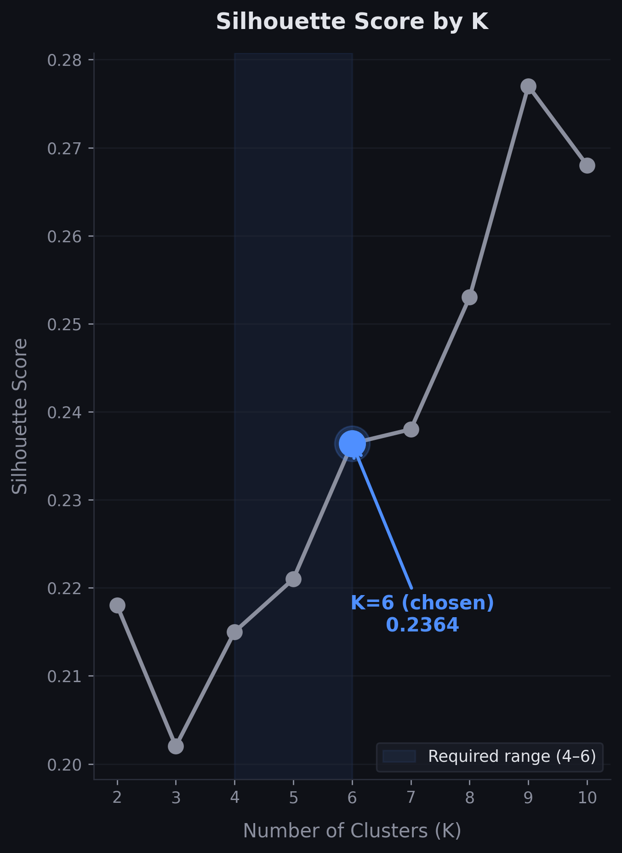
Model 2 — Clustering
Task: Group 65 products into 4–6 meaningful categories
Why not use existing categories?
primaryCategories is useless — 92% of products are just "Electronics" or "Health & Beauty"
We needed categories a shopper would recognize
Method:
Combined product names + cleaned category labels
TF-IDF vectorization (unigrams + bigrams, 200 features)
K-Means clustering
Tested K=2 to K=10
Chose K=6 - best silhouette within required 4-6 range (0.2364)
Notes:
For clustering, the project says group products into 4 to 6 categories. The dataset has a primaryCategories column, but it's useless — 92% of products fall into just two categories. So we built our own. We combined product names with category labels, vectorized them with TF-IDF, and ran K-Means. We tested K from 2 to 10. Within the required 4-to-6 range, K=6 won at 0.2364. Let me show you what those 6 clusters look like.
[~45 seconds] K

Slide 8
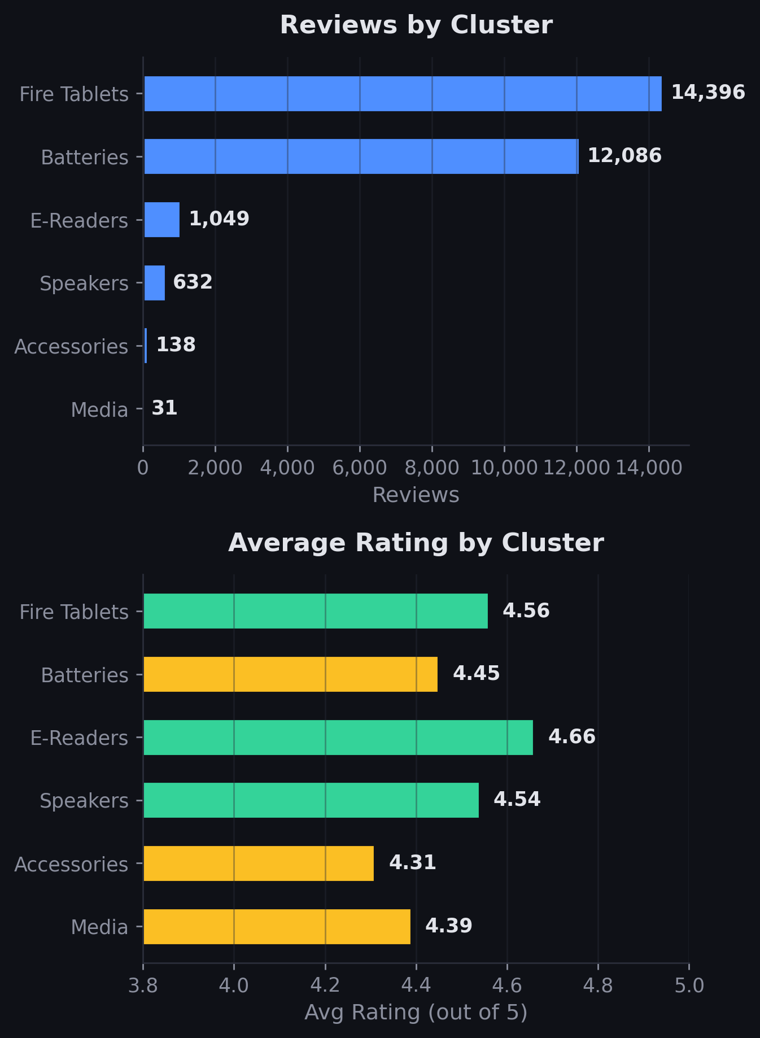
Model 2 - Evaluation
6 Clusters Found
Fire Tablets | 20 products | 14,396 reviews | ★ 4.56 Batteries | 7 products | 12,086 reviews | ★ 4.45 E-Readers | 10 products | 1,049 reviews | ★ 4.66 Smart Speakers | 9 products | 632 reviews | ★ 4.54 Accessories | 11 products | 138 reviews | ★ 4.31 Media & Home | 8 products | 31 reviews | ★ 4.39
Do they make sense? Yes:
Every Kindle → E-Readers ✓
Every Fire tablet variant → Fire Tablets ✓
Batteries separated from electronics ✓
Named clusters manually after inspecting members
Notes:
Here are the 6 clusters. Fire Tablets and Batteries dominate — 93% of all reviews. But the interesting finding is E-Readers: highest satisfaction at 95.2% positive and only 1.5% negative. Batteries have the most complaints at 9.5% negative. Do the clusters make sense? Yes — all Kindles land in E-Readers, all Fire tablets group together, batteries separate from electronics. We named them manually after inspection. These clusters become the categories for our recommendation articles.
[~45 seconds] K

Slide 9
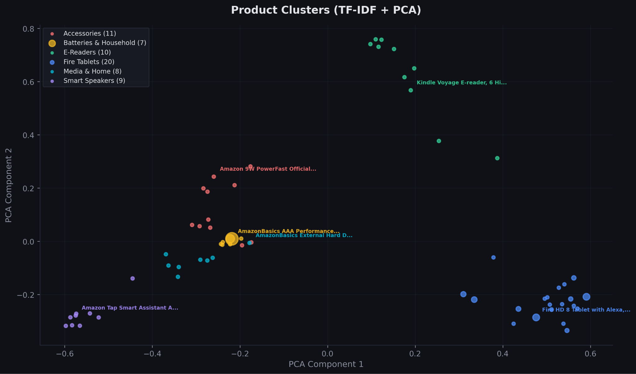
Notes:
K

Slide 10
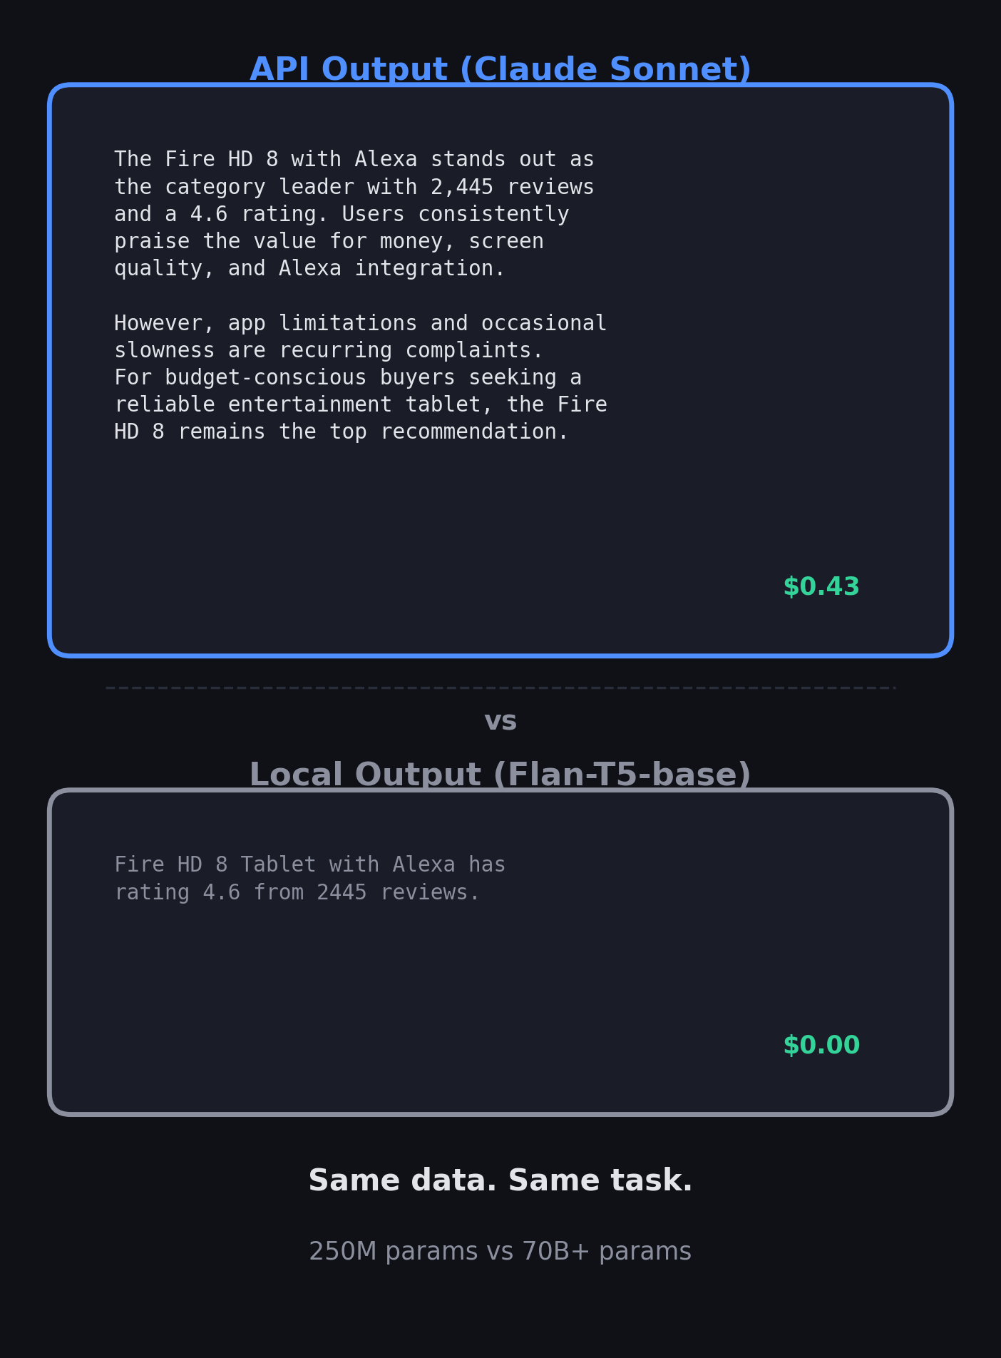
Model 3 - Summarization
Task: Generate recommendation articles per category
Two parallel approaches:
API - Claude Sonnet
Sample 5 positive, 5 negative, 3 neutral reviews per product
Send with stats to LLM via structured prompts
Output: 600-word articles with top products, complaints, recommendations
Cost: $0.43 total for 39 summaries
Local - Flan-T5-base (250M params)
Build evidence briefs with product rankings + TF-IDF complaints
Smart ranking: avg_rating × log(review_count)
Run entirely on GPU, no API needed
Cost: $0.00
Notes:
For summarization, we took two approaches. I used the Anthropic API — Claude Sonnet — sampling the most informative reviews per product and prompting for structured articles. Felipe ran Flan-T5-base locally on his GPU. Look at the difference. The API produces rich, 600-word articles with recommendations, complaints, and buying advice for 43 cents total. T5-base produces one sentence. This isn't a knock on Felipe's work — his data pipeline with the ranking formula and complaint extraction was excellent. The model just doesn't have enough capacity at 250 million parameters. It's a clear demonstration that model size matters for generation tasks.
[~1 minute] F

Slide 11
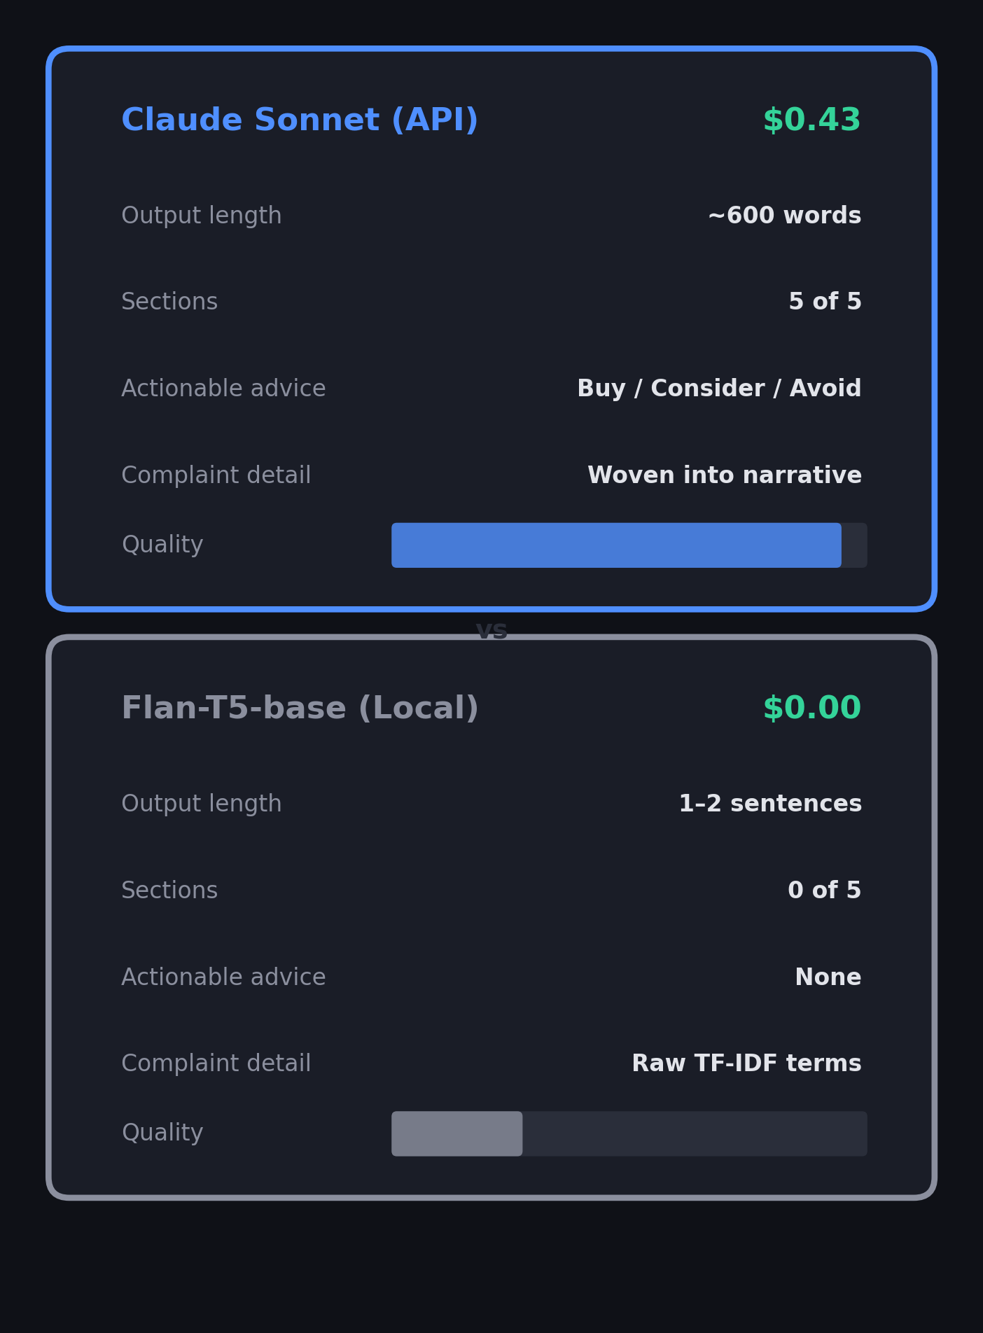
Model 3 - Evaluation
How Do You Evaluate Generated Text?
| API (Claude) | Local (T5) -------------------------------------------------------------------------------- Structure | All sections | No sections Length | ~600 words | 1–2 sentences Factual accuracy | Correct stats | Correct but minimal Actionable advice | Buy/Consider | None Complaints | In narrative | Raw TF-IDF terms Cost | $0.43 | $0.00
Both approaches deployed to the website side-by-side Users can switch between API and Local tabs to compare Demonstrates the quality-cost tradeoff transparently
https://giwojno.pl/review-analyzer/
Notes:
Evaluating generated text is tricky — there's no single number. So we compare qualitatively. The API output has structure, actionable advice, specific complaints woven into prose. The local output is factually correct but minimal. Rather than picking one winner, we deployed both to the website side-by-side. You can switch between Categories API and Categories Local tabs and judge for yourself. It's a transparent demonstration of the quality-cost tradeoff — $0.43 versus free, and you can see exactly what that buys you.
[~45 seconds] F

Slide 12
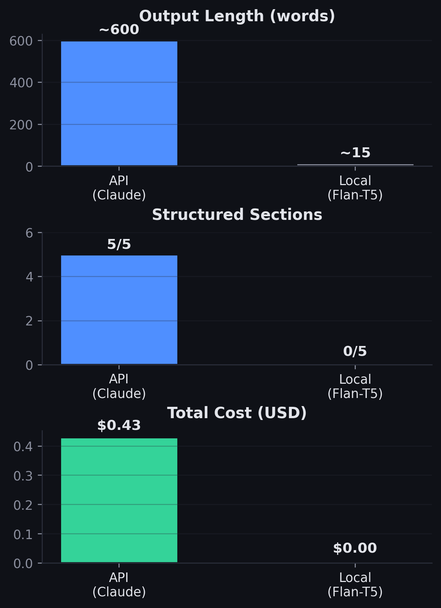
Model 3 - Evaluation
How Do You Evaluate Generated Text?
| API (Claude) | Local (T5) -------------------------------------------------------------------------------- Structure | All sections | No sections Length | ~600 words | 1–2 sentences Factual accuracy | Correct stats | Correct but minimal Actionable advice | Buy/Consider | None Complaints | In narrative | Raw TF-IDF terms Cost | $0.43 | $0.00
Both approaches deployed to the website side-by-side Users can switch between API and Local tabs to compare Demonstrates the quality-cost tradeoff transparently
https://giwojno.pl/review-analyzer/

Slide 13
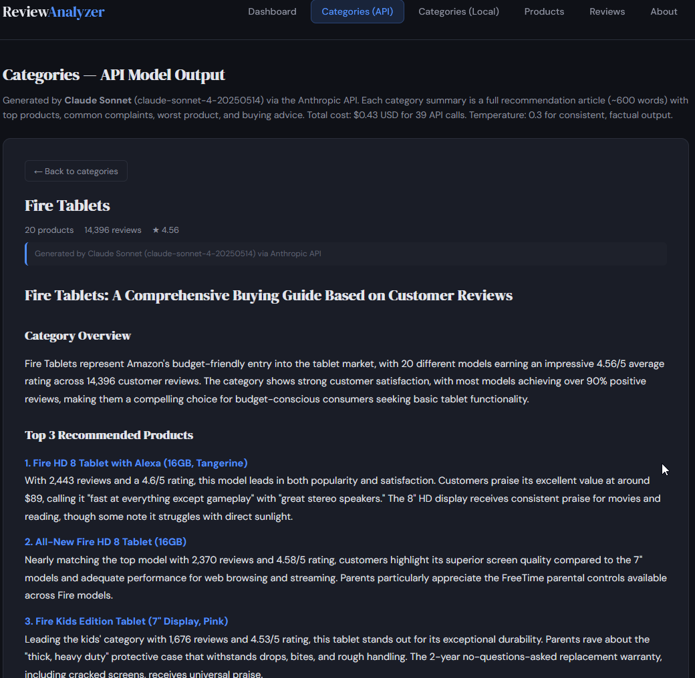
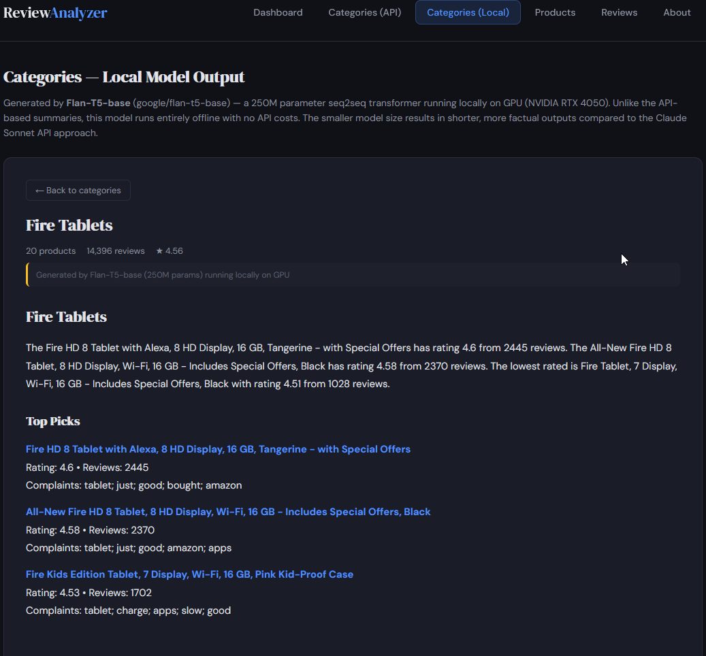
Notes:
F

Slide 14

Takeaway
What we built: A complete NLP pipeline from raw reviews → deployed web app
95.48% accuracy → 6 clusters → 39 summaries → Live website
Both API ($0.43) + Local models deployed side-by-side
Live at https://giwojno.pl/review-analyzer
What We Learned
Class weights matter - they doubled Neutral F1 from 0.27 to 0.57
Model size matters - 250M params can't do what an API model does for $0.43
Keep it simple - static site, no backend, pre-compute everything
Bonus point pitch: We deployed a fully functional public website on real hosting - not localhost, not a notebook, not Gradio. A static site architecture that pre-computes all results, needs zero backend, and works on the cheapest shared hosting available. You can open it right now on your phone.
Notes:
Let me recap. We built a complete pipeline — classification, clustering, summarization, all deployed on a live website. Three things we learned. First, class weights are everything when your data is imbalanced — they doubled our Neutral F1. Second, model size matters for generation — Flan-T5 at 250 million parameters just can't do what Claude does for 43 cents. Third, keep it simple — we pre-compute everything and serve static files, no backend, no database. For the bonus point — this isn't a localhost demo or a Gradio app. It's a real website on real hosting. Scan the QR code and try it yourself while I show you the demo.
[~30 seconds] F

Slide 15
Takeaway
What we built: A complete NLP pipeline from raw reviews → deployed web app
95.48% classification accuracy (RoBERTa)
6 meaningful product clusters (K-Means)
39 AI-generated summaries for $0.43
Both API + Local models deployed side-by-side
Live at https://giwojno.pl/review-analyzer
Bonus point pitch: We deployed a fully functional public website on real hosting - not localhost, not a notebook, not Gradio. A static site architecture that pre-computes all results, needs zero backend, and works on the cheapest shared hosting available. You can open it right now on your phone.
Notes:
Let me recap. We built a complete pipeline: classification at 95.48% accuracy, 6 product clusters, 39 AI summaries for 43 cents, all deployed on a live website with both API and local model outputs shown transparently. For the bonus point — we didn't just run a Gradio app on localhost. We built a static site that pre-computes everything, needs no backend, and it's live right now on real hosting. You can scan this QR code and browse it on your phone while I show you the demo.
[~30 seconds] F

Slide 16
Demo
Notes:
K

Slide 17
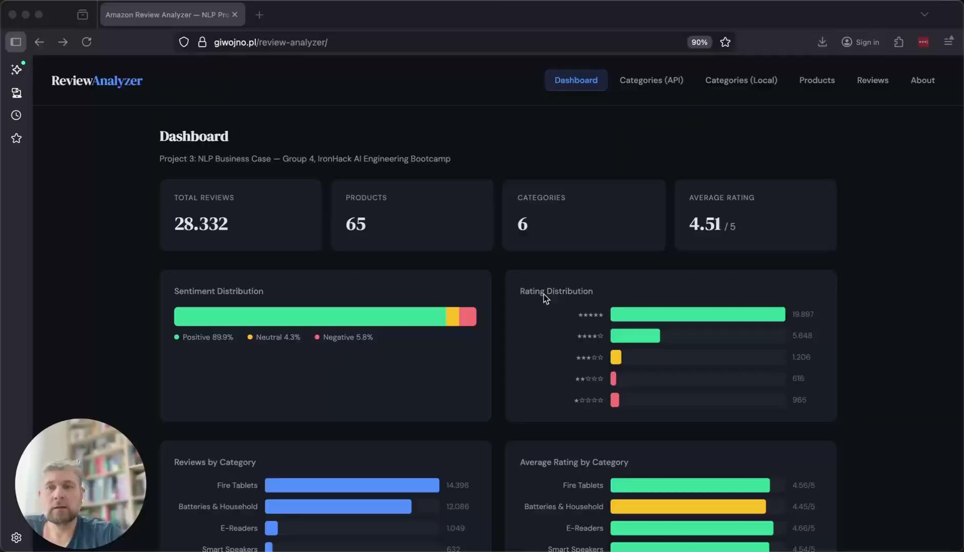
Notes:
https://www.loom.com/share/8cd7ab72d58d4933a9cedf55f9e9f71b

Slide 18


